Slide 1

Integration Testing

Slide 2
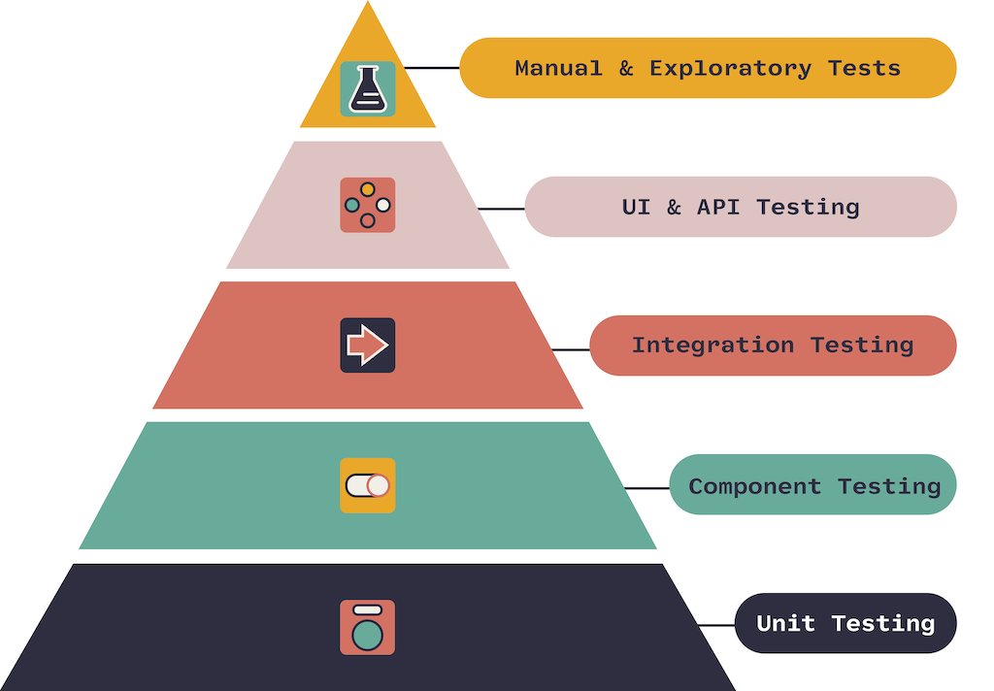
Testing Pyramid

Slide 3

Integration Testing Concept

Slide 4
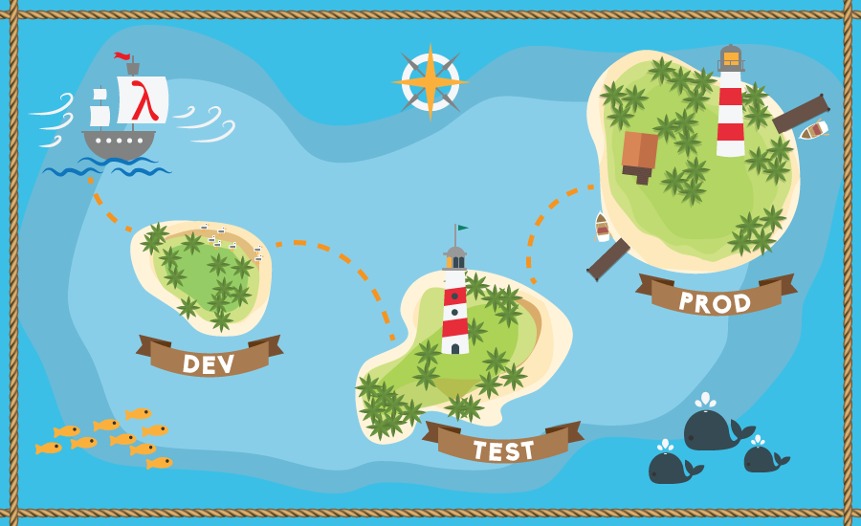
@TestPropertySources
@TestPropertySource - is a class-level annotation that is used to configure the locations of properties files and inlined properties to be added to the Environment's set of PropertySources for an ApplicationContext for integration tests.

Slide 5

Example - @TestPropertySource
https://github.com/vrudas/spring-framework-examples/blob/main/notes-app/src/test/java/io/sfe/notesapp/TestPropertySourcesTest.java

Slide 6
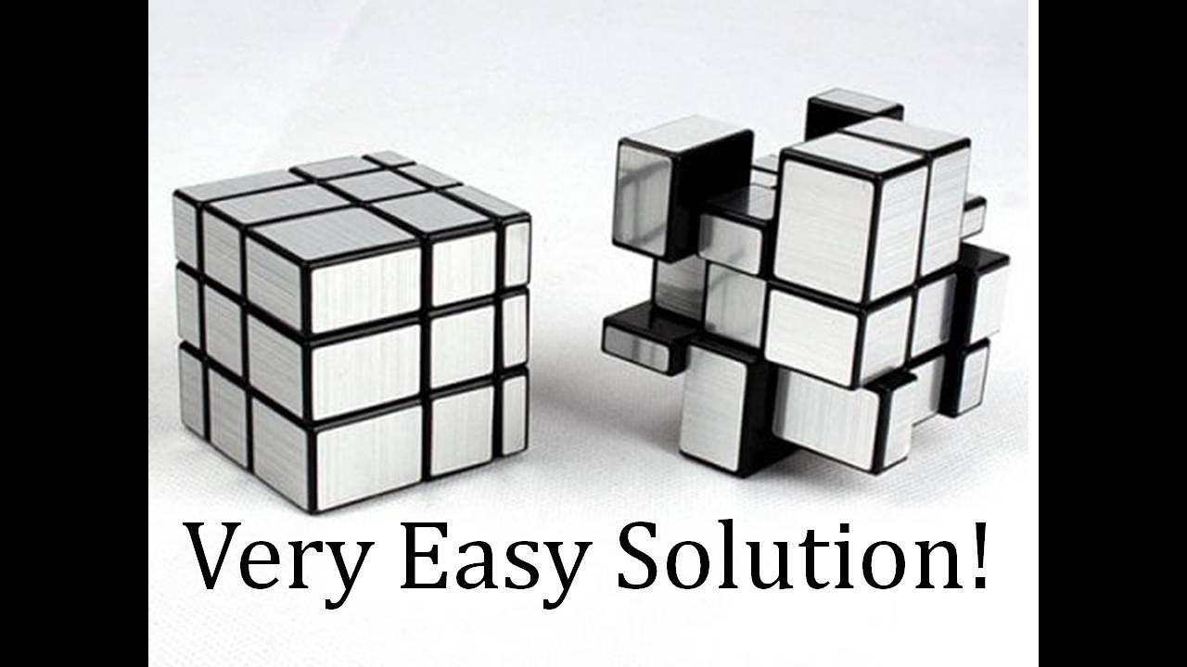
@ContextConfiguration
@ContextConfiguration - defines class-level metadata that is used to determine how to load and configure an ApplicationContext for integration tests.

Slide 7
Example - @ContextConfiguration
https://github.com/vrudas/spring-framework-examples/blob/main/notes-app/src/test/java/io/sfe/notesapp/domain/note/NoteServiceContextConfigurationTest.java

Slide 8
@SpringBoot for help

Slide 9
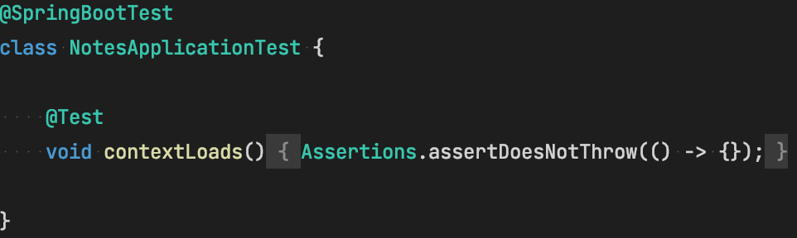
Example - Spring Boot Integration test

Slide 10
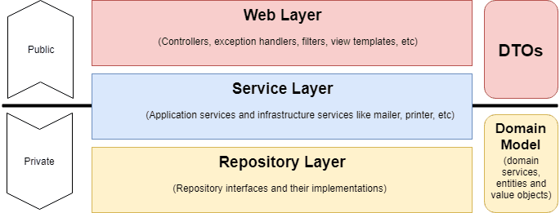
Layered Testing Concept

Slide 11
Spring Boot Layered Testing
@JdbcTest - focuses only on JDBC-based components (tests are transactional and roll back at the end of each test. They also use an embedded in-memory database).
@DataJdbcTest - focuses only on Data JDBC components (tests are transactional and roll back at the end of each test. They also use an embedded in-memory database).
@WebMvcTest - focuses only on Spring MVC components (auto-configure Spring Security and MockMvc).
@SpringBootTest - is useful when we need to bootstrap the entire container (aka Integration Test).

Slide 12
Example - @JdbcTest (NoteTableSchemaTest)
https://github.com/vrudas/spring-framework-examples/blob/main/notes-app/src/test/java/io/sfe/notesapp/storage/note/NoteTableSchemaTest.java

Slide 13
Example - @DataJdbcTest (NoteRepositoryTest)
https://github.com/vrudas/spring-framework-examples/blob/main/notes-app/src/test/java/io/sfe/notesapp/storage/note/NoteRepositoryTest.java

Slide 14
Example - @JdbcTest (NoteJdbcTemplateRepositoryTest)
https://github.com/vrudas/spring-framework-examples/blob/main/notes-app/src/test/java/io/sfe/notesapp/storage/note/NoteJdbcTemplateRepositoryTest.java

Slide 15

H2 Problem
Using in-memory databases for tests reduce the reliability and scope of your tests
Missing features and optimizations:
You skip the tests for some features completely
You change the application’s SQL code just to make it run in both the real and the in-memory database.

Slide 16

Test containers
Instead of a database running on the local machine or in a VM for DAO unit tests or end-to-end integration tests that need a database to be present. In this context, the benefit of Testcontainers is that the database always starts in a known state, without any contamination between test runs or on developers' local machines

Slide 17
Docker
Image
Register
Container

Slide 18
Example - TestContainers

Slide 19
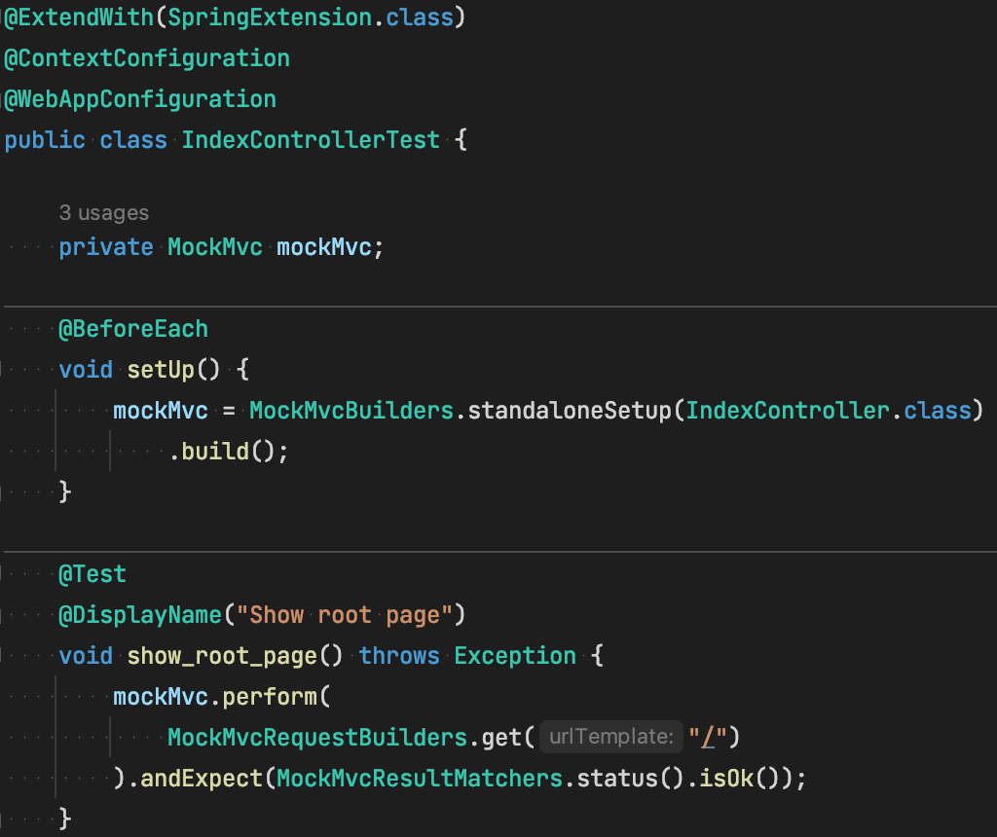
Example - Spring Web MVC Manual Config

Slide 20
Example - MockMvcResultMatchers
https://github.com/vrudas/spring-framework-examples/blob/main/notes-app/src/test/java/io/sfe/notesapp/web/IndexControllerTest.java

Slide 21
Example - @WebMvcTest
https://github.com/vrudas/spring-framework-examples/blob/main/notes-app/src/test/java/io/sfe/notesapp/web/note/NoteControllerTest.java

Slide 22
Example - Business Domain Integration Test
https://github.com/vrudas/spring-framework-examples/blob/main/notes-app/src/test/java/io/sfe/notesapp/domain/note/NoteServiceIntegrationTest.java

Slide 23
Example - Full Control Flow Integration Test
https://github.com/vrudas/spring-framework-examples/blob/main/notes-app/src/test/java/io/sfe/notesapp/web/note/NoteControllerIntegrationTest.java

Slide 24
More Spring Boot Layered Testing
@DataMongoTest - can be used for a MongoDB test that focuses only on MongoDB components.
@JooqTest - focuses only on jOOQ-based components.
@JsonTest - focuses only on JSON serialization.
@DataJpaTest - focuses only on JPA components.
@RestClientTest - only on beans that use RestTemplateBuilder (apply only configuration relevant to rest client tests (i.e. Jackson or GSON auto-configuration and @JsonComponent beans, but not regular @Component beans)).
@WebFluxTest - focuses only on Spring WebFlux components.

